Slide 1
FHIR for specifiers
Michel Rutten
HL7 WGM Orlando, Januari 2016

Slide 2
Who am I?
Name: Michel Rutten
Company: Furore, Amsterdam
Background:
Professional software developer since 1998
Microsoft .NET; Healthcare industries
Technical Specialist at Furore since May 2014
Member of the Furore FHIR development team
Toolsmith - Lead developer of Forge

Slide 3
Contents of this tutorial
Introduction to FHIR Conformance Layer
Principal components
FHIR Conformance Resources
Implementation Guides
ValueSet
StructureDefinition
Registry

Slide 4
Introduction FHIR Conformance Layer
Notes:
Time start-10:00 (10 minutes)

Slide 5
The need for profiling
Many different contexts in healthcare, but a single set of Resources
FHIR provides a “platform specification”
Requires further adaptation to context of use

Slide 6
The need for profiling
Need to be able to describe adaptations based on use and context
Which resources and elements are used?
Which API features are used?
Which terminologies are used?
How to map these to local requirements/implementations?

Slide 7
The need for profiles
Allow for these usage statements to be:
Authored in a structured manner
Published in a repository
Used as the basis for validation, code, report and UI generation.

Slide 8
Define FHIR “Profiling”?
General term:
The process of creating a conformance resource
The process of creating a conformance package
The process of creating an implementation guide

Slide 9
Principal components FHIR Conformance layer
Notes:
Time start-10:00 (10 minutes)

Slide 10
Conformance Resources
Terminology
Naming System
Value Set
Concept Map
Content
Structure Definition
Data Element
Operations
Operation Definition
Search Parameter
Conformance
Misc.
Implementation Guide
Test Script

Slide 11
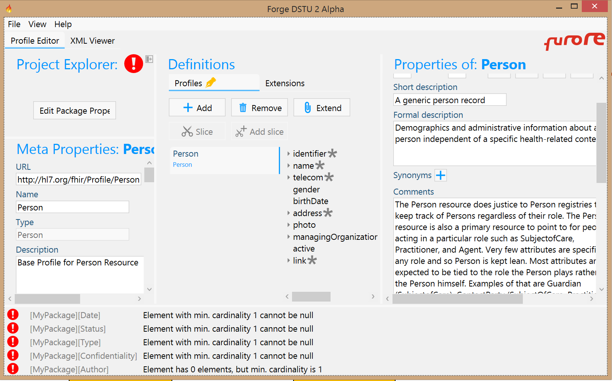
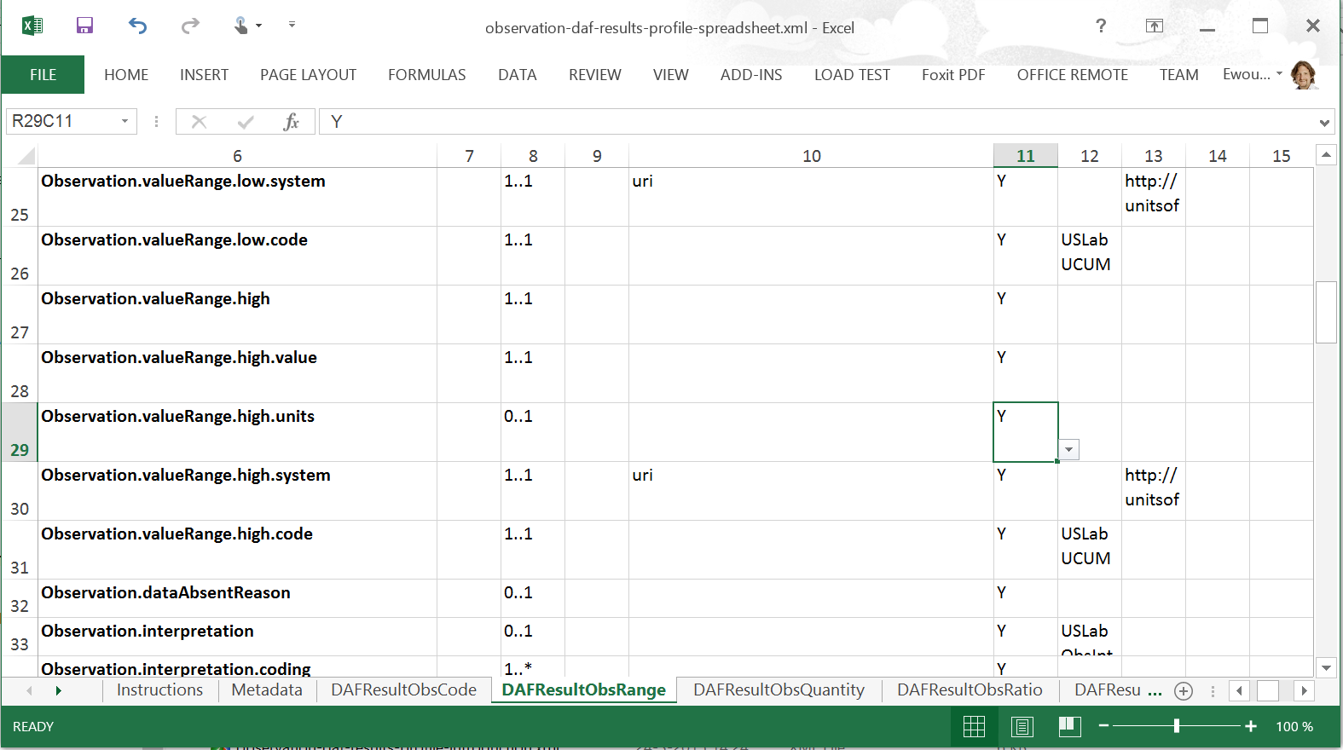

Conformance Resources
“Profile”
Forge
Implementation Guide
Structure Definition
Excel
ValueSet
Concept
Map
Conformance
SearchParam Definition
NamingSystem
Operation Definition
TestScript
11
Notes:
Also: TestScript resource

Slide 12
Terminology
ValueSet
NamingSystem
ConceptMap
Define which terminologies to use in which elements
Define namespaces with unique symbols
Define mappings between terms from different systems

Slide 13
Content
StructureDefinition
DataElement
Define data structures
Define restrictions and/or extensions
Define data elements (ISO 11179)

Slide 14
Operations
Define server capabilities
Define supported API methods
Define additional (custom) operations
SearchParameter
Define additional (custom) searches
OperationDefinition
Conformance

Slide 15
Miscellaneous
ImplementationGuide
Define compliance tests against a FHIR server
Author and publish an implementation guide
TestScript

Slide 16
Overview FHIR Conformance resources
Notes:
Time start-10:00 (10 minutes)

Slide 17
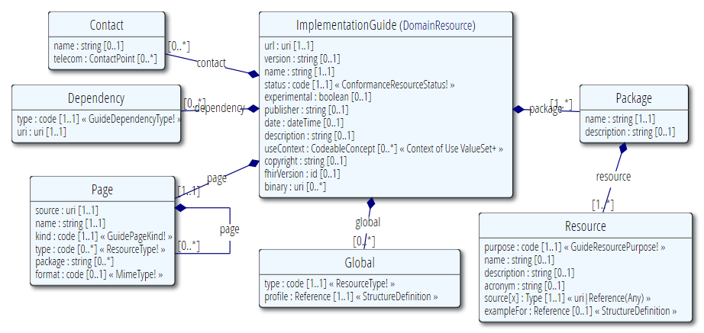
ImplementationGuide
Define scope of usage
Describes requirements for an implementation

Slide 18
ImplementationGuide
Usage:
Allow authors to publish an implementation guide
Allow tools to validate conformance
Computable!

Slide 19
ImplementationGuide
Packages = group of related resources
Adaptations (conformance resources)
Examples (any type of resource)
Pages = editorial content
Global = profiles that apply globally
Dependency = reference to other IG

Slide 20
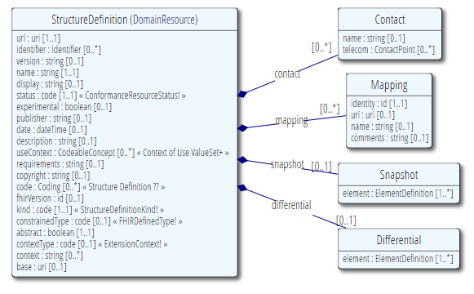
StructureDefinition
Defines datastructures
Core resources & datatypes (see validation.zip)
Constraints on resources & datatypes
Extensions

Slide 21
StructureDefinition
Share/publish to repository / registry
Compare
Validate resource
Use to drive
Code generation
Report generation
UI generation (e.g. ClinFhir ResourceBuilder)
Computable!

Slide 22
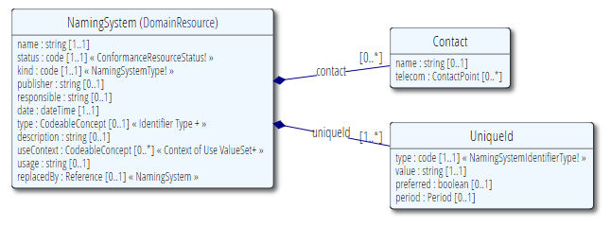
NamingSystem
Describes “logical” numbering systems in use
What’s the name?
What are equivalent uri/uuid/oids
Represents a "System" used within the Identifier and Coding data types.
Notes:
http://hl7.org/implement/standards/fhir/2015May/namingsystem.html
“Represents a "System" used within the Identifier and Coding data types.”
http://hl7.org/implement/standards/fhir/2015May/terminologies-systems.html

Slide 23
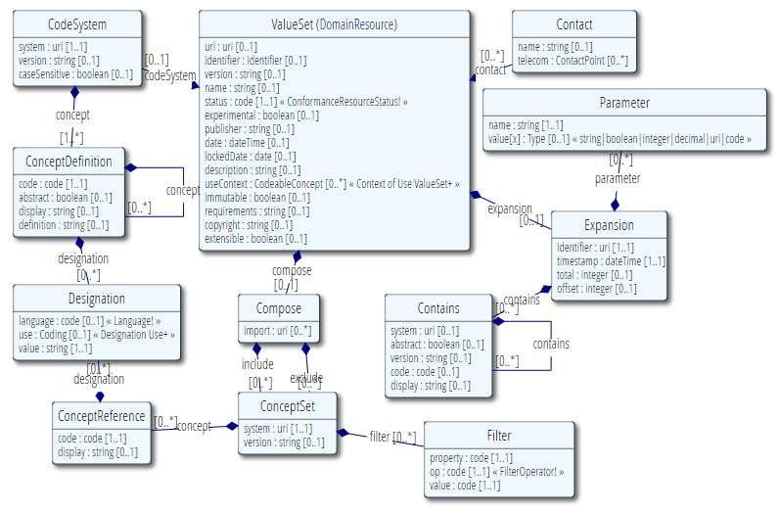
ValueSet
Define codes

Slide 24
ValueSet
Code System
Defines a set of codes with meanings (also known as enumeration, terminology, classification, and/or ontology)
Value Set
Selects a set of codes from those defined by one or more code systems

Slide 25
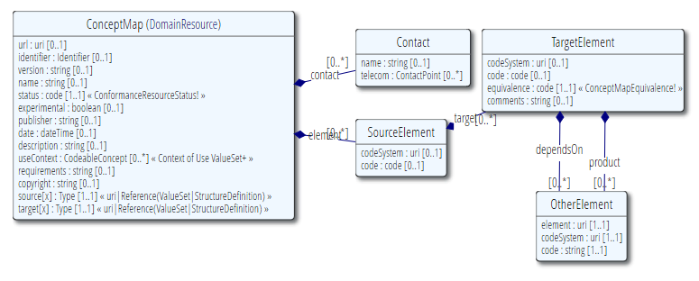
ConceptMap
Define mapping
From one set of concepts to one or more other concept(s)
Notes:
http://hl7.org/implement/standards/fhir/conceptmap-example-specimen-type.html
v2 table 0487 => SNOMED-CT

Slide 26
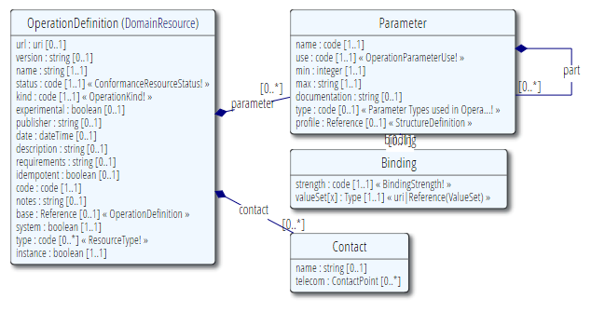
OperationDefinition
Extend/restrict the API
Defines interactions
Notes:
Show examples of operation definitions on http://hl7.org/implement/standards/fhir/2015May/valueset-operations.html

Slide 27
OperationDefinition
Describes additional operations over and above the RESTful interactions defined in the specification
What is the name?
Input/output parameters
What does it do?
Works on which resources?
Notes:
Example: http://hl7.org/implement/standards/fhir/operation-valueset-validate-code.html
ValueSet validation

Slide 28
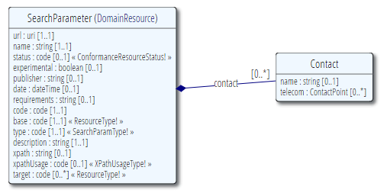
SearchParameter
Extend/restrict searches
Describes additional searches to filter resources
What is the name?
Elements filtered
Resource the search works on
Notes:
Note: better resource name would be “SearchParameterDefinition”
Example: HelseNord REKVIRENT extension

Slide 29
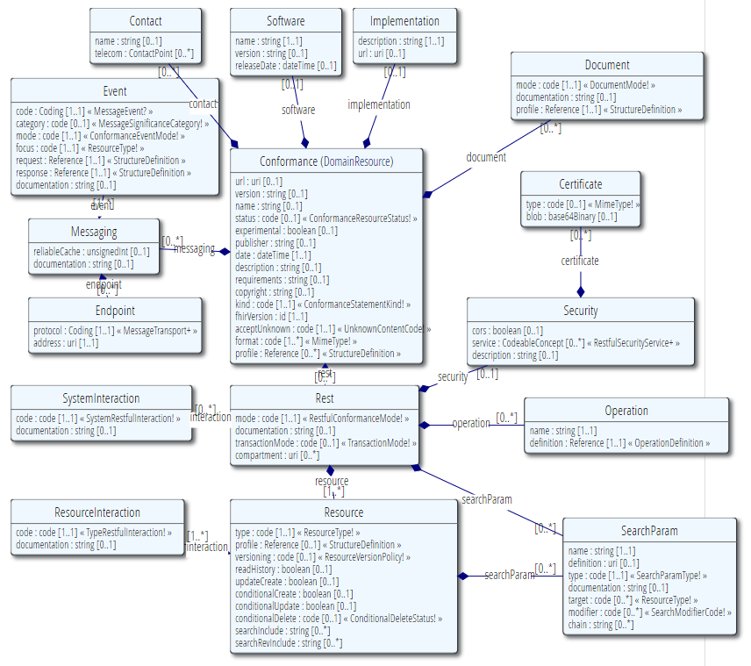
Conformance
A set of capabilities of a FHIR Server
Binds all conformance resources together
Notes:
Note: better resource name would be “SearchParameterDefinition”

Slide 30
Conformance
Describes how a client or server uses or should use the FHIR API
Which wire formats supported?
Which resources?
Which operations supported?
Which profiles supported?
Is this a test server?
What’s the name of the software?
Notes:
Note 1: API performs an (optional) version check on the first call
Note 2: Conformance resource for a fully fledged FHIR server can be quite large, e.g. 1.5MB

Slide 31
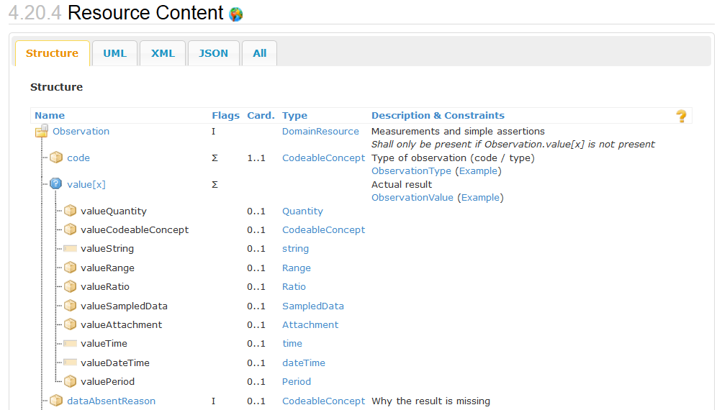
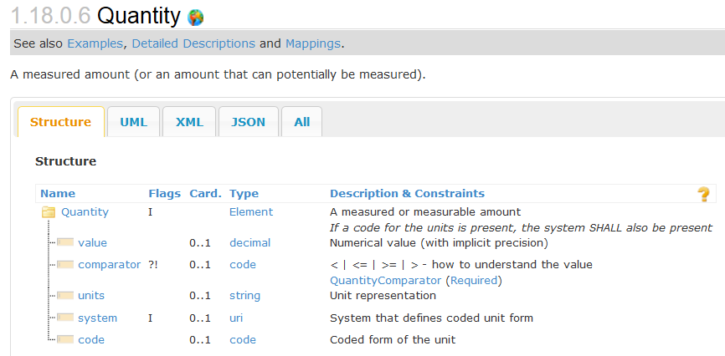
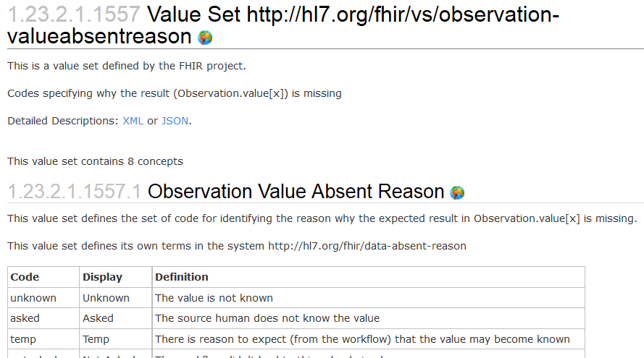
Used in the core spec
For implementer convenience, the specification itself publishes its base definitions using these same resources!

Slide 32
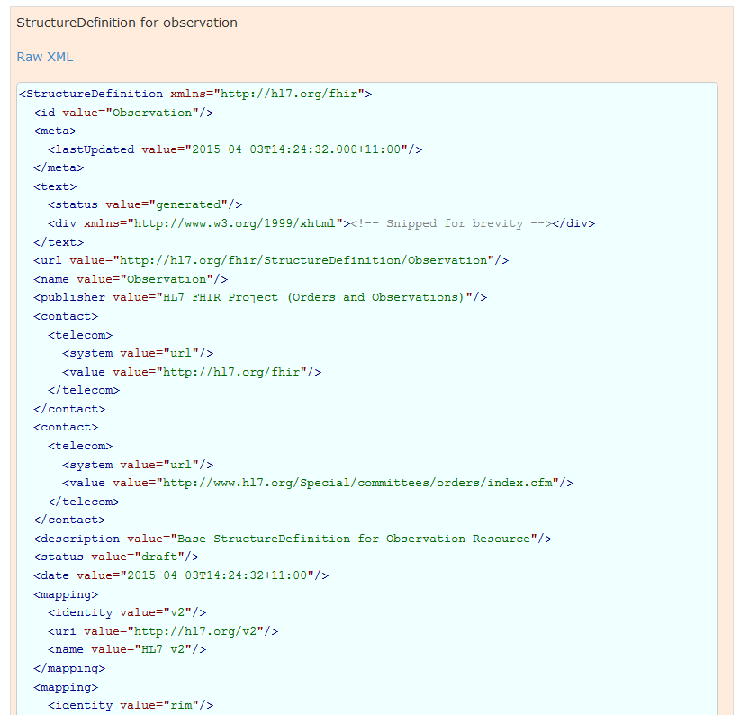
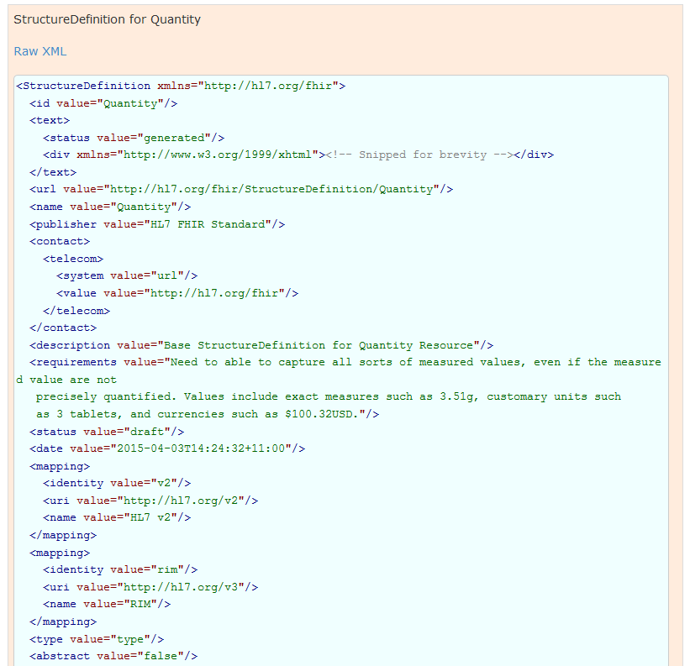
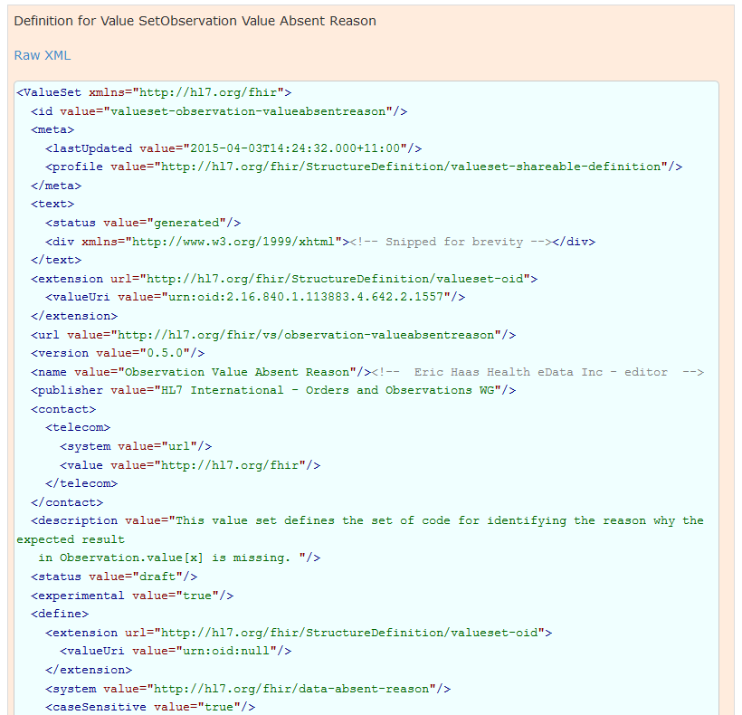
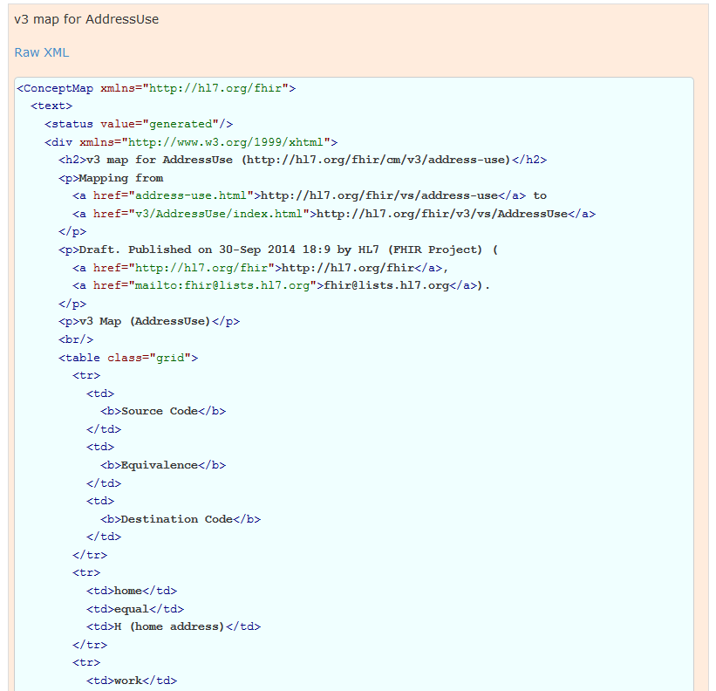
Used in the core spec
For implementer convenience, the specification itself publishes its base definitions using these same resources!
Notes:
See next slide for HTML rendering of these XML structures…

Slide 33
Implementation guides
Notes:
Time start-10:00 (10 minutes)

Slide 34
Examples
fhir.hl7.org
Implementation > Implementation Guides
Argonaut
DAF
QICore
SDC
USLab

Slide 35
Different Kinds
Strategy
National scope guide
Principles
Overarching principles
Subject
Subject with multiple usecases
Usecase
Single usecase
e.g. medication process
e.g. prescription
e.g. basic components
e.g. infrastructure, security

Slide 36
Structure of a Profile
Introductory narrative
Scope & boundaries
Mapping to high-level terms from usecases
Profile specific guidance
Datastructures (StructureDefinitions)
Core extensions used
Valuesets
Operations, Search Parameters
NamingSystems
May be re-used on Implementation Guide level to share across profiles!
Notes:
Note: this relates to a Profile documentation page in an implementation guide

Slide 37
Typical Content
Title
Table of contents
Document information
Introduction to the guide
Principles & background
Functional requirements and high-level use cases
Design considerations
Package contents (= use case?)
Privacy and security guidance
Testing and certification
Appendix
List of all artifacts used in this guide
Notes:
Best practices, guidelines, default template
Recommended, not mandatory

Slide 38
ImplementationGuide
New resource type introduced in DSTU2 1.0
Defines:
Conformance Packages
Documentation Pages
Global Profiles
Dependencies

Slide 39
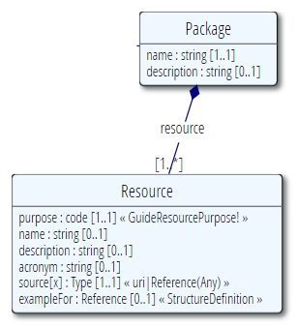
Conformance Package
Defines a set of conceptually related conformance resources
Provides example resources
Allows conformance validation of resources

Slide 40
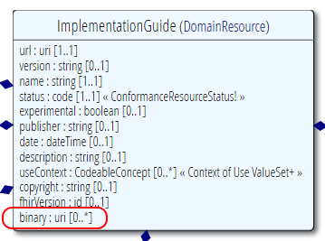
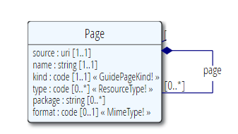
Documentation Pages
Provides detailed description of the included conformance resources
E.g. HTML, Markdown
Binaries: css, js, img, …

Slide 41
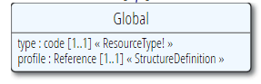
Global Profiles
A set of profiles that all resources covered by this implementation guide must conform to
Note: A resource can conform to the default profile by conforming to any profile derived from it
Notes:
http://hl7.org/implement/standards/fhir/implementationguide.html#default
Note: a resource can conform to the default profile by conforming to any profile derived from it

Slide 42
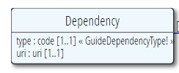
Dependencies
Other ImplementationGuide resources this guide depends on
Type
Reference (hyperlink)
Inclusion (embed)
Notes:
Type: How the dependency is represented when the guide is published
Reference - The guide is referred to by URL
Inclusion - The guide is embedded in this guide when published

Slide 43

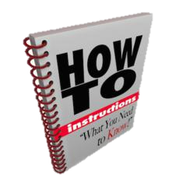
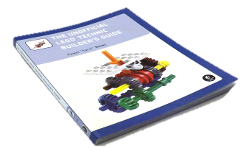




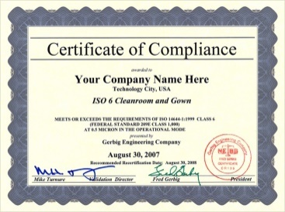

Publish!
Guide
Author & Store
Publish
http://simplifier.net
http://registry.fhir.org
Implement
Test & Verify
Notes:
Authoring workflow ⬄ Publishing workflow

Slide 44
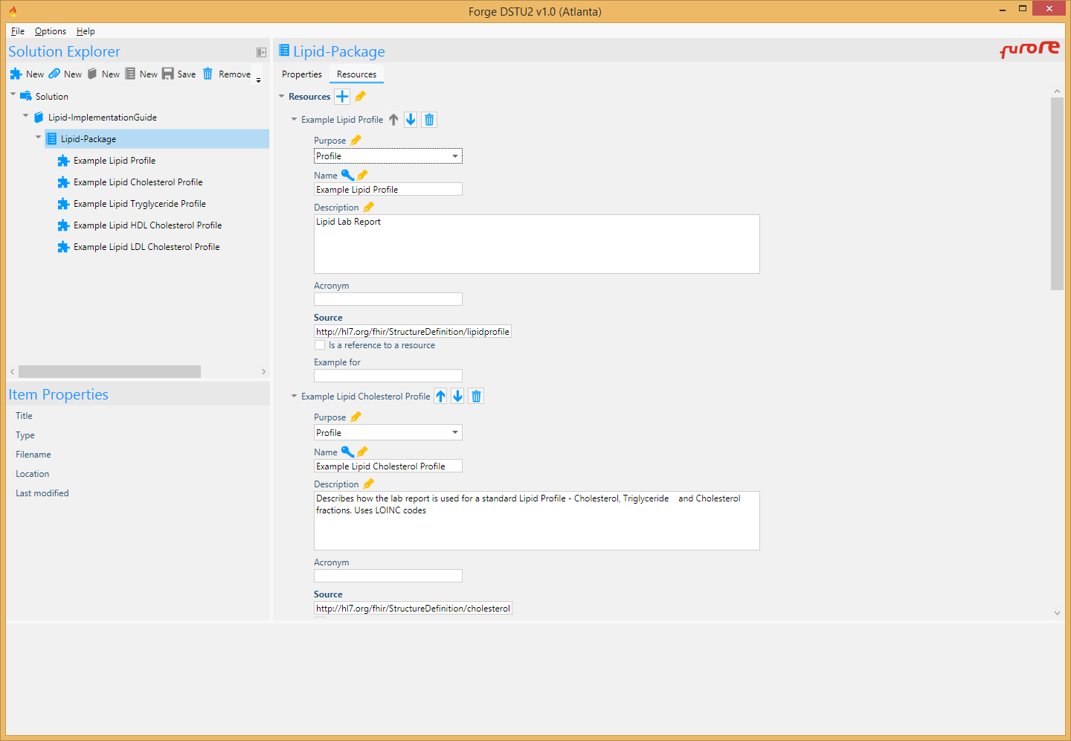
Forge - Lipid
http://hl7.org/implement/standards/fhir/lipid-report.html
Notes:
http://hl7.org/implement/standards/fhir/lipid-report.html

Slide 45
Value sets
Notes:
Time start-10:00 (10 minutes)

Slide 46
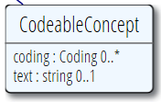
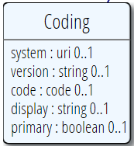
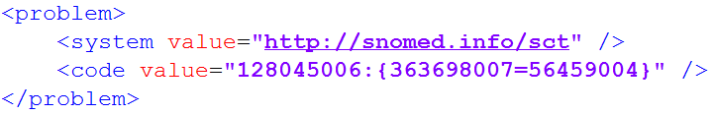
Coded types
In a Profile, we may want to limit the codes that can possibly be used in coded elements in the Resources
Codes are defined in code systems
Notes:
A CodeableConcept contains 0+ Codings

Slide 47
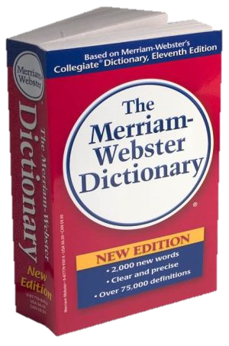
CodeSystem vs. ValueSet
“Dante’s deadly sins”
Pride
Envy
Wrath
Sloth
Avarice
Gluttony
Lust
Takes concepts from…
Definition of terms
An enumeration of terms
“Code System”
“ValueSet”
Example: SNOMED-CT
Example: “Childhood diseases”

Slide 48

“Special” cases
No need to write them all down!
Takes concepts from…
“All words under B”
“All words in the
Merriam-Webster dictionary”
“Words for ‘nerd’”
Bookworm
Geek
Grind
Weenie
Wonk
Dink (slang)
Dork (slang)
Swot (slang)
Takes concepts from…
Takes concepts from…
Can take concepts from multipe codingsystems!

Slide 49
Identification of CodeSystems
If you refer to CodeSystems, you use a URL (instead of OID in v2 and v3):
http://snomed.info/sct
http://loinc.org
http://hl7.org/fhir/sid/icd-10
We have introduced them for v2 and v3:
http://hl7.org/fhir/v2/0078
http://hl7.org/fhir/v3/ActClass
Notes:
Some codesystems don’t have an “official” url yet (used to be OID)
Note: ICD-10 did not (yet) claim own domain

Slide 50
Coded types (again)
The uri of the system
Notes:
[WMR] Coding.ValueSet has been removed in DSTU-2

Slide 51
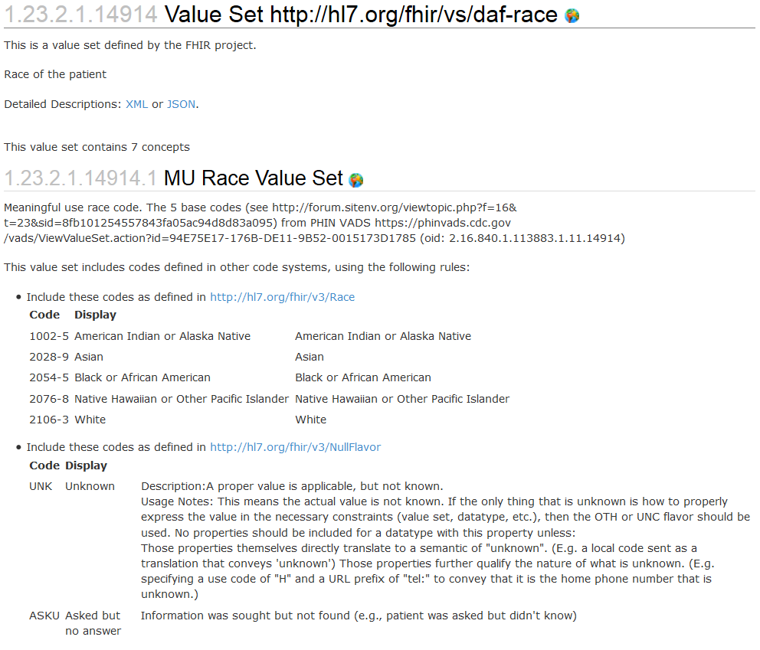
Notes:
Bindings use ValueSets to define what codes are allowed.
DAF us-core-race extension (for DAF Patient) has a binding using the valueset “http://hl7.org/fhir/vs/daf-race”
This valueset includes codes from two code systems http://hl7.org/fhir/v3/Race and http://hl7.org/fhir/v3/NullFlavor
So yes, FHIR reused code systems from v3 (and v2), and has some defined specifically for FHIR.

Slide 52
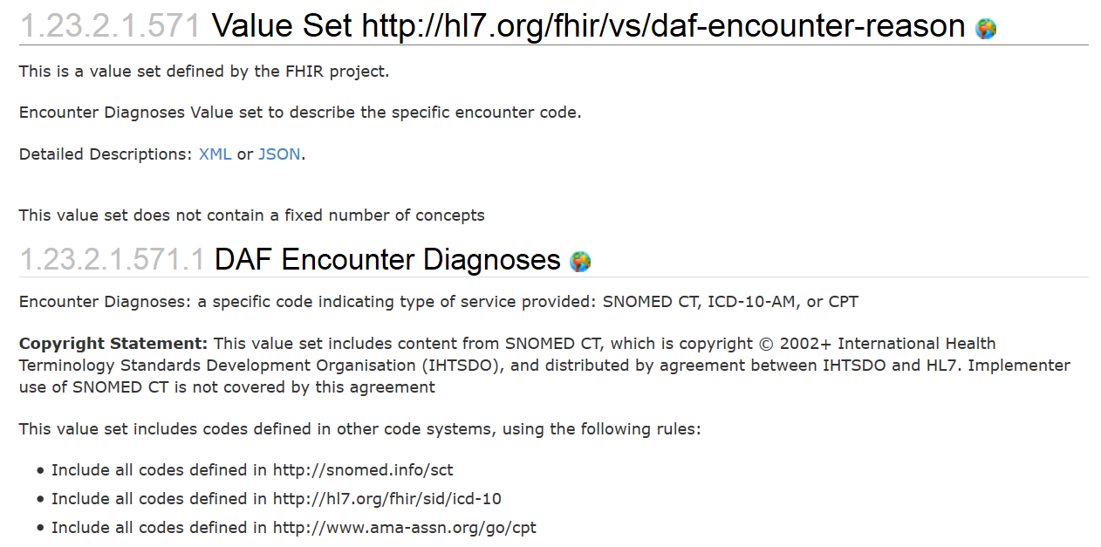
ValueSets
Notes:
Bindings use ValueSets to define what codes are allowed.
StructureDefinition DAFEncounter has a binding using the valueset “http://hl7.org/fhir/vs/daf-encounter-reason”
This valueset includes codes from three code systems
So yes, FHIR reused code systems from v3 (and v2), and has some defined specifically for FHIR.

Slide 53
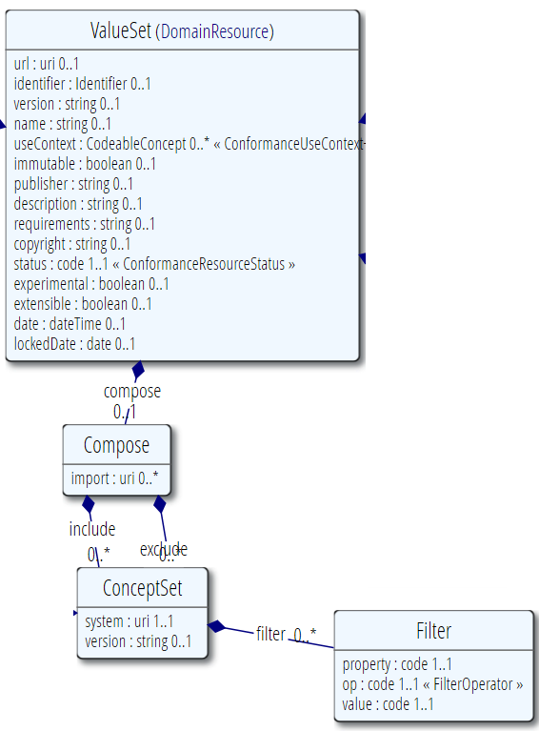
ValueSets
Metadata
This models what we have been discussing so far:
A ValueSet has metadata (much like Profile: identifier, version, name, etc)
A ValueSet is built by inclusion of terms from CodeSystems
A ValueSet can exclude specific codes from other valuesets
A ValueSet can import codes from other ValueSets
Include/Exclude Concepts

Slide 54
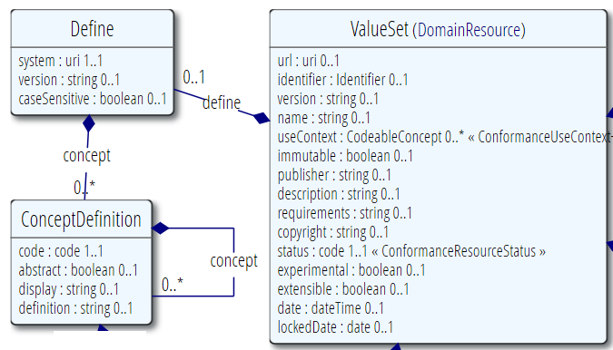
ValueSets
But it can also enumerate (and so indirectly define) all concepts for a new codesystem
A ValueSet has metadata (much like Profile: identifier, version, name, etc)
A ValueSet is built by defining terms from and for a new CodeSystem
These new concepts have a display label and a definition
…and may be hierarchically organized

Slide 55
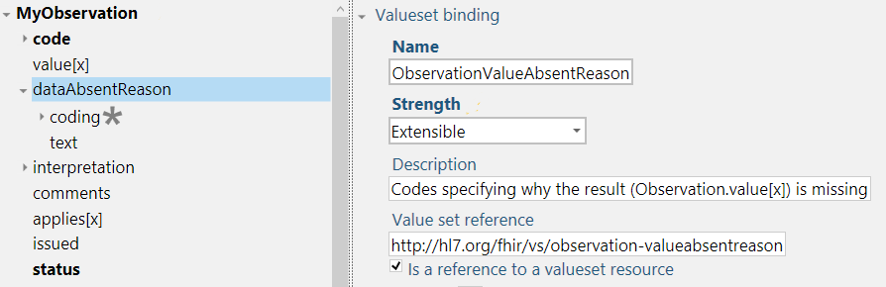
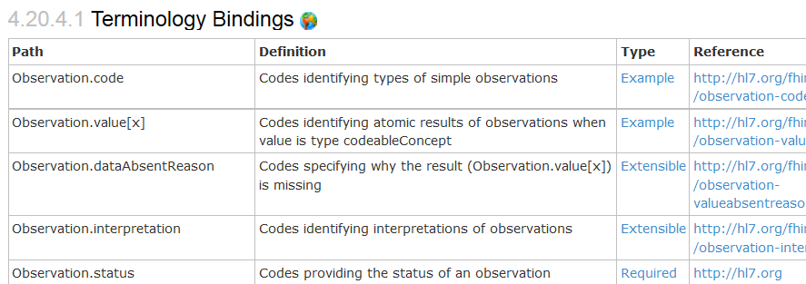
Bindings
When used in a Resource, the modelers include Bindings
Bindings specify which codes can be used
Notes:
Examples is from http://hl7.org/implement/standards/fhir/2015May/observation.html

Slide 56
Profiling bindings
Depending on “core” spec, you can:
“required”: not specify a different binding
“extensible”: specify a different binding if needed
“preferred”: specify a different binding if desired
“example”: very likely specify a different binding
Change the bindings as specified in core:
Define a new ValueSet
Allow additional codes, Restrict to a subset
Specify whether implementers of your profile can deviate from your valueset.
Notes:
Two aspects: whether you as a profile author can change the valueset and
Whether the user of your profile can provide codes from other valuesets in an instance

Slide 57
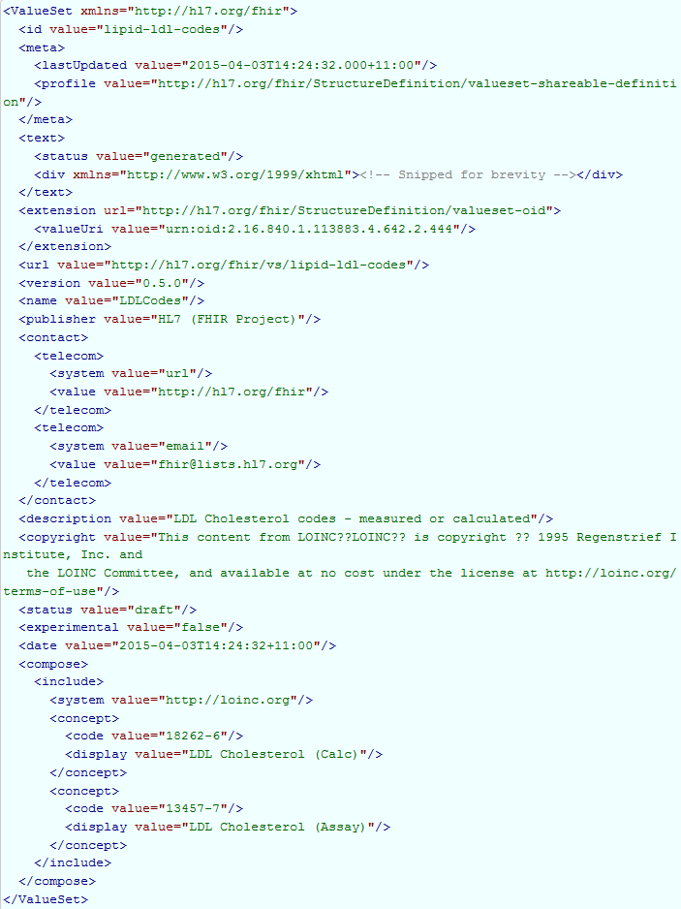
This is not too hard…

Slide 58
ValueSet Editor
Grahame
Apolon
…

Slide 59
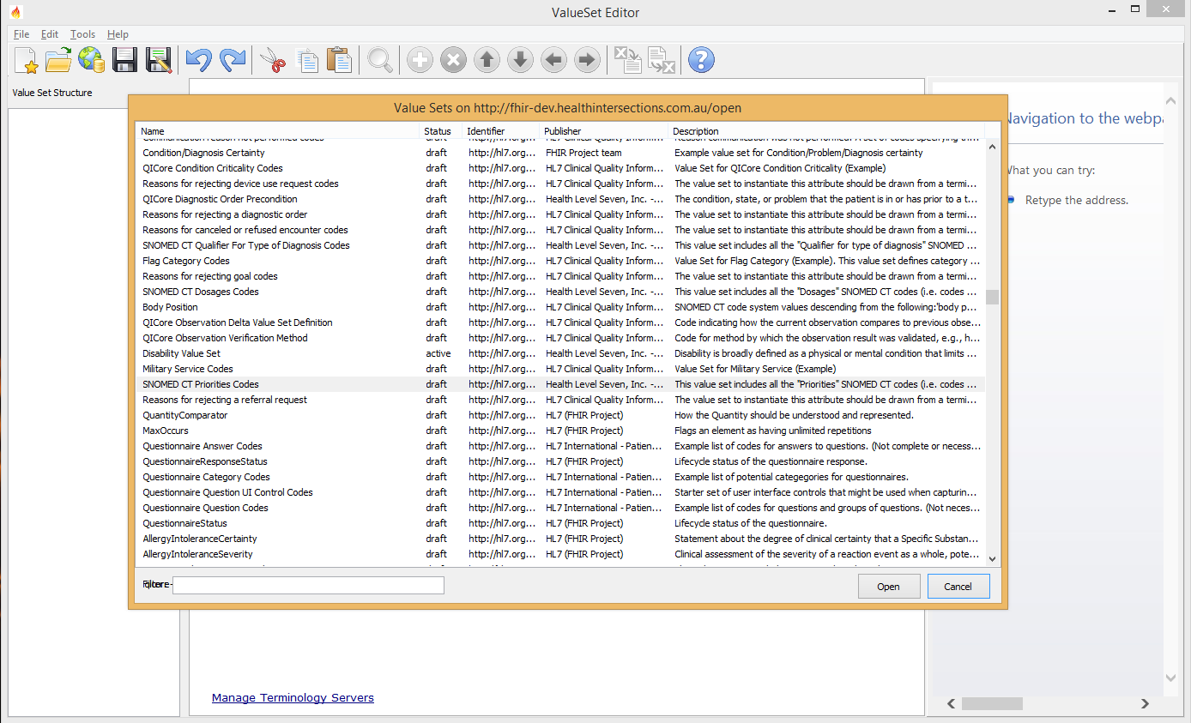
ValueSet Editor
Notes:
Example: SNOMED CT Priorities Codes

Slide 60
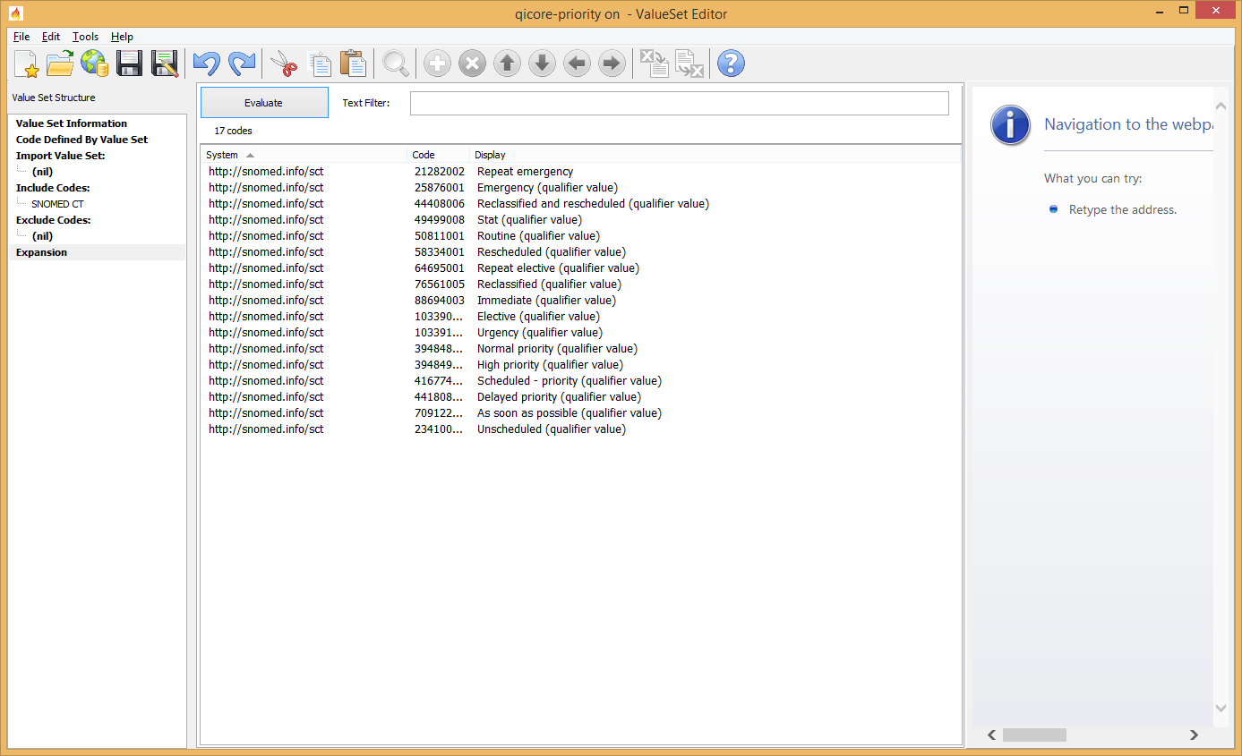
ValueSet Editor
Notes:
Example: SNOMED CT Priorities Codes

Slide 61
Refer to ValueSet
Create a ValueSet for Practitioner.role
In Xml & by hand…
Or use e.g. Grahame’s editor
Use SNOMED codes for roles
Use Forge to limit Practitioner.role to this new ValueSet
Notes:
Open valueset-practitioner-role.xml
Add term, change name, save
Update Practitioner.role binding

Slide 62
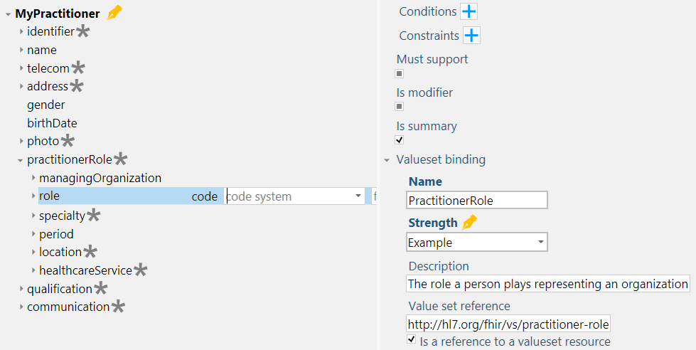
Refer to ValueSet
Notes:
Open valueset-practitioner-role.xml
Add term, change name, save
Update Practitioner.role binding

Slide 63
Structuredefinition

Slide 64
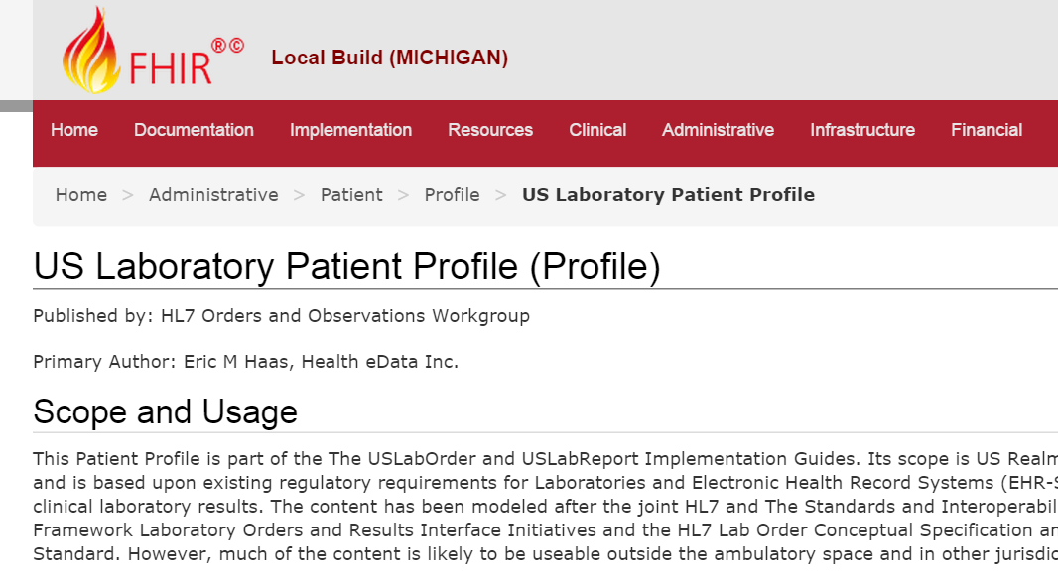
Work on Profiles…

Slide 65
Profiling a resource
“Must use only the Dutch national patient identifier”
+
“Need to register an administrative race code for a Patient in the US”
“Patient Discharge documents must at least contain section “Discharge Medication” and section “Discharge Diagnosis”
+
“In our Patient registration system, we use these maritalStatus codes beyond those provided by HL7…”
“Our patient registration system, only supports having one single name per Patient”
Notes:
Both restrictions (only one single name) and additions (race extension, maritalStatus valueset)

Slide 66
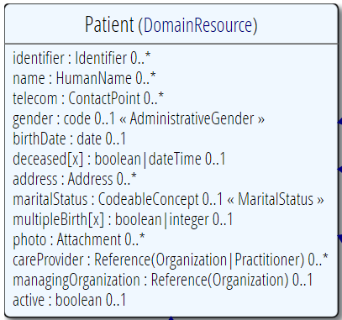
Profiling a resource
Demand that the identifier uses your national patient identifier
Limit names to just 1 (instead of 0..*)
Limit maritalStatus to another set of codes that extends the one from HL7 international
Add an extension to support “RaceCode”
Note: hardly any mandatory elements in the core spec!

Slide 67
Uses for profiles
Server & client may publish and check their conformance to a profile
Validating instances, messages
Implement "FHIR spec-like" website from Profiles as part of an Implementation Guide

Slide 68
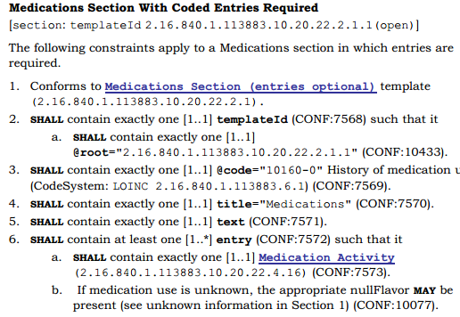
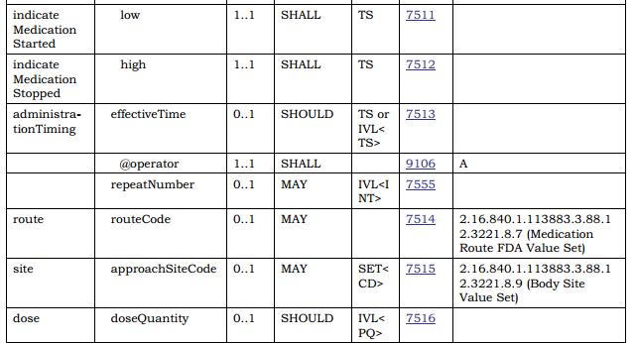
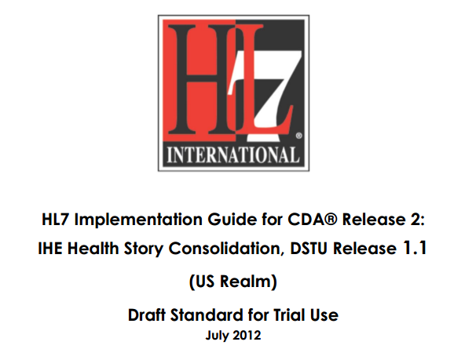
In v3 CDA…”text-based”

Slide 69
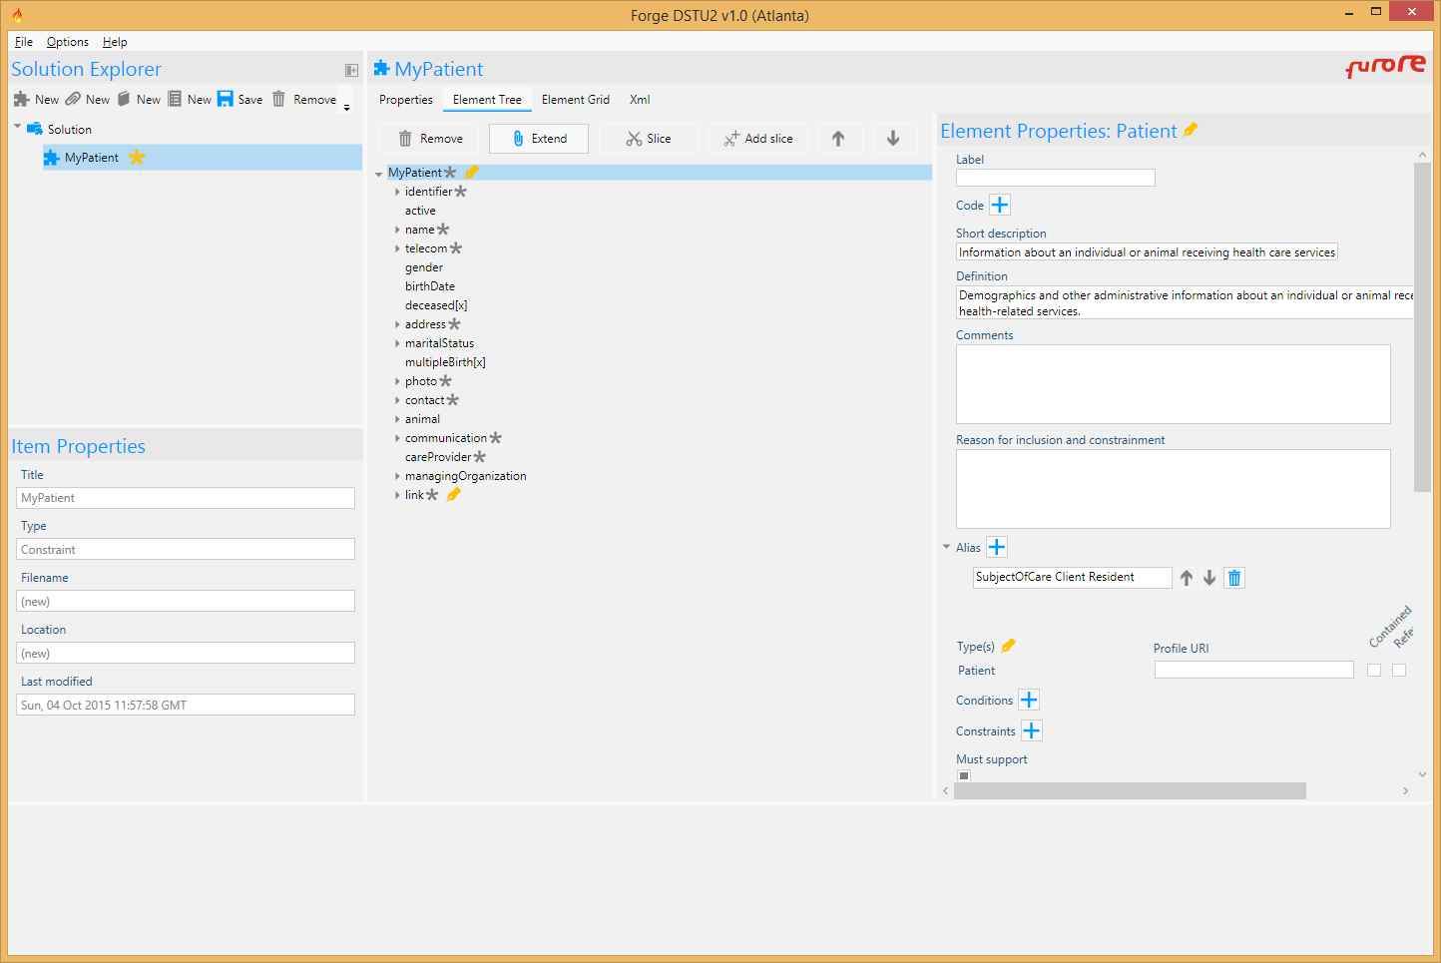
Write by hand…? Forge!

Slide 70
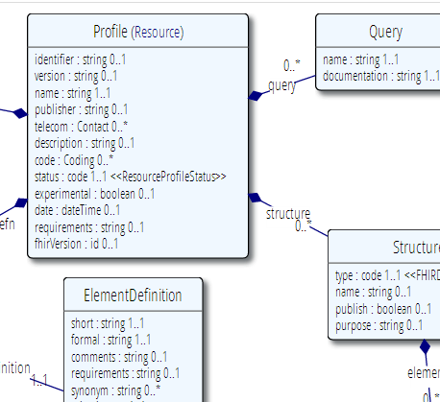




Publish!
Find & maintain
http://simplifier.net
http://registry.fhir.org
Retrieve & use
Notes:
A profile can be published on a FHIR (based) server (it’s a Resource, after all)
On Foundry: http://simplifier.net
Or in a version-management system, or by e-mail, or…
As long as people can *find* them, because publishing your profile should help others to find & adhere to it.

Slide 71



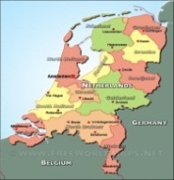
Who publishes?
http://www.hl7.org/Profile/iso-21090
http://www.data4all.nl/d4all-obs
http://www.hl7.nl/Profile/patient-nl
http://www.fit4all.nl/f4all-vitals
http://www.health4all.nl/h4all-vitals
Notes:
“Drive-by” or “bottom-up” operability: “Communicate first, standardize later”
First, business partners. Then, collaborations, communities. Maybe, finally, nation-wide
It’s a natural process that people will want to make it work first, then only coordinate what they really need to, and then realize they can broaden their approach to a community.
“Support”, of course top-down should still be possible! Maybe even a combi in the long-term
You don’t need a central authority to model your data, before you can start.

Slide 72
Layered profiles
HL7 Norge adapts Patient for Norway
Helse Nord/Vest/… introduces regional differences
Use-case specific constraints
Constrain
Feedback
Constrain

Slide 73
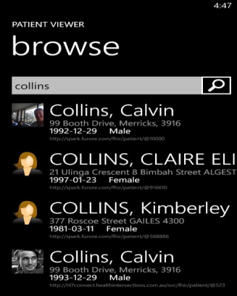
(Distributed) validation
DIPS’s server
Profile NO
Profile HNIKT
Profile HNIKT, DIPS
Store
Validate NO
Download & Validate
Profile NO
Norway national validation server
Notes:
A server might defer validation to another server (because it doesn’t know the profile)
A server may fetch the “unknown” profile and validate it itself
There may be several servers sharing the work
HNIKT = Helse Nord IKT

Slide 74
Examples…
Let’s look at DAF Profiles
http://fhir.hl7.org
Implementation
Implementation Guides
DAF
Notes:
Visit http://hl7.org/implement/standards/fhir/daf/daf.html
http://hl7.org/fhir => Implementation Guides => DAF
Example: DAF Patient - http://hl7.org/implement/standards/fhir/daf/daf-patient.html

Slide 75
Example: Lipid
We are taking the “Lipid Profile” example from the spec from now on.
This is a DiagnosticReport, containing 4 results:
1x Cholesterol
1x Triglyceride
1x HDL Cholesterol
0/1x LDL Cholesterol
Notes:
Forge demo: lipid-report.project.xml
Note: message is excluded from demo –complex, requires advanced concepts (slicing)
=> Open the lipid project bundle: lipid-report-lipidprofile.bundle.xml

Slide 76
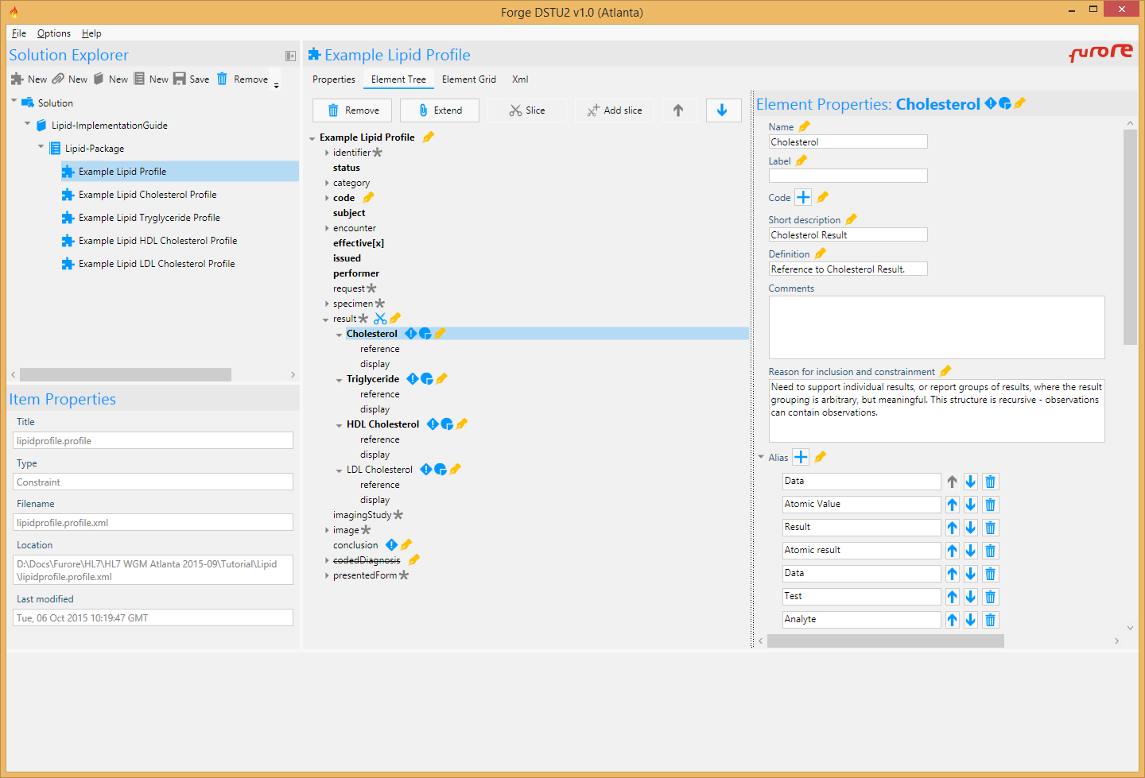
Forge - Lipid

Slide 77
Metadata and versions
Notes:
Time start-10:00 (10 minutes)

Slide 78
What’s in a profile?
StructureDefinition for DiagnosticReport
Metadata “Lipid Profile” v1.0.0 Draft
urn:acme.org:lipid-profile:v1
Author: e.kramer@furore.com
DiagnosticReport instances (via Tag)
Structure “LipidProfile”
Element Definitions …
Structure
Observation
“Triglyceride”
Structure
Observation
“LDLCholesterol”
Extension “calculated”
Notes:
Metadata + Element Definitions
A Conformance Package contains one or more related conformance resources (structure definitions, extension definitions, value sets, …)
Individual conformance resources can reference other (related) conformance resources, e.g. extension definitions

Slide 79
Tagging a Resource
Practitioner
“Doctor Bernard”
30-11-1972
“I’m a Practitioner conforming to the Norwegian Profile – see http://hl7.no/StructureDefinition/patient-no”
“I’m a Practitioner acting as a Prescriber – see http://hnikt.no/StructureDefinition/prescriber”
“I’m a Practitioner as supported by DIPS - see http://dips.com/StructureDefinition/dips-practitioner”
Notes:
Note: Practitioner is an concrete resource instance – NOT a resource definition!
DIPS = Norwegian Epic
DSTU-2: Resource.Meta.profile (uri)
http://hl7.org/implement/standards/fhir/2015May/resource.html#Meta

Slide 80
Referring to a profile
Observation
Cholesterol
6.3 mmol/L
High
(recommended 4.5)
http://acme.org/
http://acme.org/StructureDefinition/LDLCholesterol
Metadata “Lipid Profile” v1.0.0 Draft
urn:acme.org:lipid-profile:v1
Author: e.kramer@furore.com
I’m conforming to
http://acme.org/StructureDefinition/LDLCholesterol
Structure “cholesterol”
Notes:
* You can formalize these constraining statements into a Profile Structure called ‘cholesterol’
* An Observation instance may use a Tag to assess conformance to that structure
* Validators check the contents of the instance against these constraints.
DSTU-2: Resource.Meta.profile (uri)
http://hl7.org/implement/standards/fhir/2015May/resource.html#Meta

Slide 81
Versioning…
A “version” – author assigned
So what if you change something after publishing?
Just a typo? Change of definition?
Make something optional that wasn’t?
Make something mandatory that was optional?
Add an extension?

Slide 82
“Non-breaking change”?
If old data can still be:
Validated against the new profile
Correctly interpreted against the new profile
This can only be determined by the profile’s authors (and even depends on the way it is used)
A breaking change means you are producing a new profile
The profile’s author-assigned identifier changes
A new Profile on the server, with a new REST utl
Notes:
* E.g. changing the order of questions may in some context considered breaking interpretation, while in others it is not.

Slide 83
Authoring a Profile
Excel (build tool)
MDHT https://projects.eclipse.org/projects/modeling.mdht
Let’s do this in Forge
Click “New Profile”
Select base resource, e.g. Observation
Edit metadata on tab page “Properties”
Name
URL
Save!
Notes:
Excel: FHIR Spec\v1.01\fhir-spec\site\uslab\patient-uslab-review.xls
MDHT: https://projects.eclipse.org/proposals/model-driven-health-tools, https://projects.eclipse.org/projects/modeling.mdht
Forge: Create a new Observation profile

Slide 84
Structures
Notes:
Time start-10:00 (10 minutes)

Slide 85
What’s in a profile?
Conformance Package: Lipid Report
Structure Diagnostic Report
“Lipid Profile”
Extension
“calculated”
DiagnosticReport instances (via Tag)
Structure
Observation
“Cholesterol”
Structure
Observation
“Triglyceride”
Structure
Observation
“LDLCholesterol”
Structure
Observation
“HDLCholesterol”
Notes:
A Conformance Package contains one or more related conformance resources (structure definitions, extension definitions, value sets, …)

Slide 86
What’s in a profile?
StructureDefinition: DiagnosticReport
Metadata “Lipid Profile” v1.0.0 Draft
urn:acme.org:lipid-profile:v1
Author: john.smith@furore.com
Structure “LipidProfile”
Element Definitions …
Resource Reference
Structure Definition
Observation
“Triglyceride”
Structure Definition
Observation
“LDLCholesterol”
Structure Definition
Extension
“calculated”
Notes:
StructureDefinition contains Metadata & Element Definitions

Slide 87
Structure Definitions
Profiles contain “Structure Definitions”
Base definition of a core Resource or Datatype
A set of constraints on (nested) elements of a Resource or Datatype
An extension definition
Notes:
Structure = Resource | DataType

Slide 88

Observation resource
Notes:
Note: Subject 1..1 & is a Patient. You’ll almost always want Patient, unless you’re sending a message “Retract Observation”, then you’d only need “identifier”

Slide 89
Let’s start constraining
0..1
“if no value…”
1..1
= ‘ok’
Subject 0..1? Why not 1..1 in spec?
1..1
Notes:
Note: Subject 1..1 & is a Patient. You’ll almost always want Patient, unless you’re sending a message “Retract Observation”, then you’d only need “identifier”

Slide 90
Must support?
Authors: SHALL be capable of providing a value for the element and resource
Consumers: SHALL be capable of extracting and doing something useful with the data element.
"Something useful" is context dependent. The Profile SHALL describe what it means for applications to “support” the element
Notes:
Note: the spec *never* sets this to true, since it’s context dependent.
MustSupport is defined on element level
Cf. IsModifier: defined on structure level

Slide 91
Lipid

Slide 92
extensions
Notes:
Time start-10:00 (10 minutes)

Slide 93
Extension Context
An extension has a context type
Resource, Datatype, Extension, Mapping
And a context path
(Resource) Observation
“The observation was calculated”
(Resource) Observation.value
“The observation’s ‘value’ was calculated”
(Datatype) Quantity
“This quantity was calculated” (any Quantity used in any resource!)

Slide 94

Extension Definition
Note: multiple
contexts!

Slide 95

Extending a name
Key = location of formal definition
Value = value according to definition
Notes:
http://hl7.org/implement/standards/fhir/2015May/name-part-qualifier.html
NB = Nobility
AC = Academic

Slide 96
Extensions
Let’s find a representative extension for Practitioner
E.g. Classification
http://hl7.org/implement/standards/fhir/extension-practitioner-classification.html
Add it to the Practitioner
Notes:
Hl7.org: Resources / Practitioner => Profiles
http://hl7.org/implement/standards/fhir/practitioner-extensions.html
http://hl7.org/implement/standards/fhir/extension-practitioner-classification.html
Forge: Create Practitioner
Open extension extension-practitioner-classification.xml
Extend Practitioner
Extension: Select extension-practitioner-classification
Rename to classification

Slide 97


The “Basic” resource
Now, what if you have the need for a completely “new” resource?
…then add extensions for each element

Slide 98
Formal constraints
Notes:
Time start-10:00 (10 minutes)

Slide 99
Formal constraints
…beyond cardinalities and bindings, there are a lot of other conditions you might want to formulate:
“If a Cholesterol value result is not available, use the comments field”
“A patient’s birthdate must be on or before today’s date”
These may concern a single element, or cover multiple elements.

Slide 100
Formal constraints
Uses free text (human) + xpath (executable)
Constraints should be declared on lowest element in the hierarchy that is common to all nodes referenced by the constraint.
Identified by (local) ‘Key’, involved elements refer to that id
Specify severity (“error” or “warning”)

Slide 101
Context of the constraint
“If a Cholesterol value result is not available, use the comments field”
This constraint is on the elements “valueQuantity” and “comments”
We would have to formulate this constraint on the Observation, this is the context of the constraint
We assign the constraint a “key” value that’s unique within the Observations’ constraints
We refer from both “value[x]” and “comments” to this “key”. This means: if my value changes -> revalidate the constraint

Slide 102
Example XPath
Keep in mind: the condition is satisfied when the XPath expression evaluates to “true”
“If a Cholesterol value result is not available, use the comments field”
Note: to use both is ok!
Otherwise said: not both empty
In Xpath: exists(f:valueQuantity) or exists(f:comment)
That’s a logical or, so not exclusive!
Notes:
Note: XPath expressions are an advanced topic – this sheet is intended for a developer audience

Slide 103
More XPath
“Either a valueQuantity or a comment is permitted”
not( exists(f:valueQuantity) and exists(f:comment) )
“Can only have normal range if there is a valueQuantity”
exists(f:valueQuantity) or not(exists(f:normalRange))
Steal from the spec (e.g. from Profile)
Notes:
Or ask Lloyd ;p

Slide 104
XPath concerns
Hard to implement
XPath 1 is not expressive enough
Even XPath2 expressions can get very wieldy…
Akward syntax
e.g. slicing, extensions
Limited real-world support for XPath 2
E.g. no .NET library available…

Slide 105
Introducing FHIR Path
Specifically designed for FHIR
Convenient operators & constants
Easier to define complex constraints
Expressive
Query against multiple sources
JSON / XML
POCO object model

Slide 106
FHIR Path applications
Invariants in ElementDefinition
Slicing discriminator
Search parameter paths
Error message locations in OperationOutcome
URL templates in Smart on FHIR's CDS hooks
PATCH

Slide 107
FHIR Path syntax
Syntax & formal grammar:
https://github.com/ewoutkramer/fhirpath/blob/master/fhirpath.md
Resembles .NET LINQ / Java query expressions
Example:
Patient.identifier.where(use=‘official’)
Patient.**.extension(‘…url…’)

Slide 108
FHIR Path syntax
Path | Description
path.subPath.subPath | Select all the elements on the path
telecom.value | Select all phone numbers (for a patient)
telecom.where(use = 'work').value | Select work phone number
path.value[x].subPath | Select all kinds of value
path.valueQuantity.subPath | Select only values that are quantity

Slide 109
FHIR Path special paths
Expression | Description
* | Select any child
** | Select any descendant
name* | Recursive uses of the element
$context | The original context
$resource | The original container resource
$parent | the element that contains $context
$focus | Reference to the current focus

Slide 110
FHIR Path functions
Function | Description
.where(criteria) | Filter elements that meet criteria
.item(index) | Returns item by index (0-based)
.contains(string) | Filter elements that contain a string
.matches(regex) | Filter elements that match a RegEx
.extension(string) | Filter extensions by url; shortcut for .extension.where(url = string)
.resolve() | Resolve resource references
.count() | Returns the number of elements
… more …

Slide 111
FHIR Path operators
Precedence | Operators | Description
1 | . | Path / Function invocation
2 | *, / | Multiply, divide
3 | +, - & | | Add, subtract String concatenation Union
4 | =, ~, !=, !~, >, <, >=, <=, in | Comparison operators
5 | and, xor, or, implies | Boolean operators

Slide 112
FHIR Path constants
Function | Description
%sct | url for snomed ct
%loinc | url for loinc
%ucum | url for ucum
%vs-[name] | Full url for the provided HL7 value set with id [name]
%ext-[name] | Full url for the provided HL7 extension with id [name]
custom | Define your own

Slide 113
FHIR Path libraries
Reference implementations
JavaScript
Java
Delphi
.NET
Haskell
Online demo application
http://niquola.github.io/fhirpath-demo/#/

Slide 114
FHIR Path - Acceptance
Convert FHIR path expressions to
Xpath
OCL
JSON Path
Q: promote FHIR Path to an offical (stand-alone) standard?
i.e. broader than just FHIR
A subset of CQL?

Slide 115
Resource builder
ClinFhir - David Hay
Notes:
Time start-10:00 (10 minutes)

Slide 116

ClinFhir.com

Slide 117

Select Profile

Slide 118

Edit Resource

Slide 119

Edit Profile

Slide 120
FHIR Registry
Simplifier
Notes:
Time start-10:00 (10 minutes)

Slide 121

FHIR Registry
Notes:
Demo!

Slide 122

Search
Notes:
Demo!

Slide 123

Project
Notes:
Demo!

Slide 124

Resource
Notes:
Demo!

Slide 125

Forge – Import/Publish
Beta

